Slide 1




Data Types and Variables
Numeral Types, Text Types and Type Conversion
DATA TYPES
Programming Fundamentals
SoftUni Team
Technical Trainers
Software University
http://softuni.bg

Slide 2

Table of Contents
Integer Types
Real Number Type
Type Conversion
Variables

Slide 3
Have a Question?
sli.do #tech-softuni

Slide 4


Data Types, Variables and Type Conversions

Slide 5


How Computing Works?
Computers are machines that process data
Instructions and data are stored in the computer memory
10110

Slide 6
Variables
Variables have name, data type and value
Assignment is done by the operator "="
Example of variable definition and assignment in C#
When processed, data is stored back into variables
Variable name
Data type
int count = 5;
Variable value

Slide 7

What Is a Data Type?
A data type:
Is a domain of values of similar characteristics
Defines the type of information stored in the computer memory (in a variable)
Examples:
Positive integers: 1, 2, 3, …
Alphabetical characters: a, b, c, …
Days of week: Monday, Tuesday, …

Slide 8
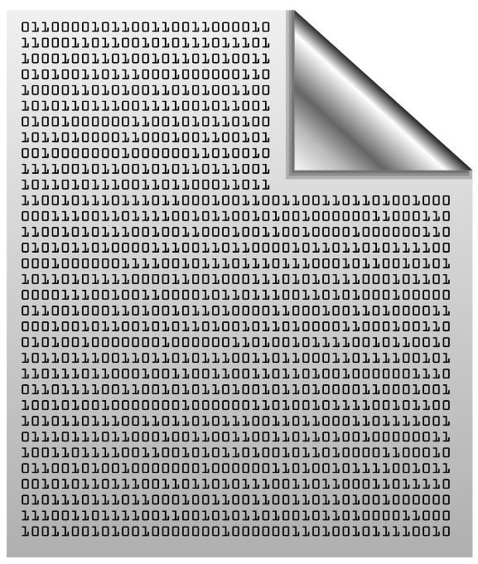

Data Type Characteristics
A data type has:
Name (C# keyword or .NET type)
Size (how much memory is used)
Default value
Example:
Integer numbers in C#
Name: int
Size: 32 bits (4 bytes)
Default value: 0
int: sequence of 32 bits in the memory
int: 4 sequential bytes in the memory

Slide 9

Integer Types
= 3

Slide 10
Integer Types
sbyte [-128 …127]: signed 8-bit [-2⁷ … 2⁷-1]
byte [0 … 255]: unsigned 8-bit [0 … 2⁸-1]
short [-32 768 … 32 767]: signed 16-bit [-2¹⁵ … 2¹⁵-1]
ushort [0 … 65 535]: unsigned 16-bit [0 … 2¹⁶-1]
int [-2 147 483 648 … 2 147 483 647]: signed 32-bit [-2³¹ … 2³¹-1]
uint [0 … 4 294 967 295]: unsigned 32-bit [0 … 2³²-1]
long [-9 223 372 036 854 775 808 … 9 223 372 036 854 775 807]: signed 64-bit [-2⁶³ … 2⁶³-1]
ulong [0 … 18 446 744 073 709 551 615]: unsigned 64-bit [0 … 2⁶⁴-1]
byte
sbyte
uint
short
int
ushort
long
ulong

Slide 11

Centuries – Example
Depending on the unit of measure we can use different data types:
byte centuries = 20; // A small number (up to 255)
ushort years = 2000; // A small number (up to 32767)
uint days = 730484; // A large number (up to 4.3 billions)
ulong hours = 17531616; // A very big number (up to 18.4*10^18)
Console.WriteLine( "{0} centuries = {1} years = {2} days = {3} hours.", centuries, years, days, hours);

Slide 12
Beware of Integer Overflow!
Integers have range (minimal and maximal value)
Integers could overflow → this leads to incorrect values
byte counter = 0;
for (int i = 0; i < 260; i++)
{
counter++;
Console.WriteLine(counter);
}
1
2
…
255
0
1

Slide 13
Problem: Centuries to Minutes
Write program to enter an integer number of centuries and convert it to years, days, hours and minutes
Centures = 1
1 centuries = 100 years = 36524 days = 876576 hours = 52594560 minutes
Centures = 5
5 centuries = 500 years = 182621 days = 4382904 hours = 262974240 minutes
Check your solution here: https://judge.softuni.bg/Contests/Practice/Index/171#0

Slide 14
Solution: Centuries to Minutes
Console.Write("Centuries = ");
int centuries = int.Parse(Console.ReadLine());
int years = centuries * 100;
int days = (int) (years * 365.2422);
int hours = 24 * days;
int minutes = 60 * hours;
Console.WriteLine("{0} centuries = {1} years = {2} days = {3} hours = {4} minutes", centuries, years, days, hours, minutes);
Tropical year has 365.2422 days
(int) converts double to int
Check your solution here: https://judge.softuni.bg/Contests/Practice/Index/171#0

Slide 15

Integer Literals
Examples of integer literals:
The '0x' and '0X' prefixes mean a hexadecimal value
E.g. 0xFE, 0xA8F1, 0xFFFFFFFF
The 'u' and 'U' suffixes mean a ulong or uint type
E.g. 12345678U, 0U
The 'l' and 'L' suffixes mean a long
E.g. 9876543L, 0L

Slide 16

Real Number Types
Floating-Point and Decimal Floating-Point Type

Slide 17
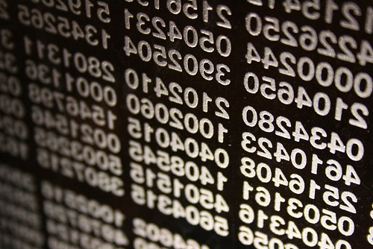
What are Floating-Point Types?
double
Floating-point types:
Represent real numbers, e.g. 1.25, -0.38
Have range and precision depending on the memory used
Sometimes behave abnormally in the calculations
May hold very small and very big values like 0.00000000000001 and 10000000000000000000000000000000000.0
float

Slide 18

Floating-Point Numbers
Floating-point types are:
float (±1.5 × 10⁻⁴⁵ to ±3.4 × 10³⁸)
32-bits, precision of 7 digits
double (±5.0 × 10⁻³²⁴ to ±1.7 × 10³⁰⁸)
64-bits, precision of 15-16 digits
The default value of floating-point types:
Is 0.0F for the float type
Is 0.0D for the double type
double
float

Slide 19
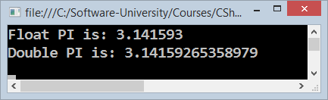
PI Precision – Example
Difference in precision when using float and double:
NOTE: The "f" suffix in the first statement!
Real numbers are by default interpreted as double!
One should explicitly convert them to float
float floatPI = 3.141592653589793238f;
double doublePI = 3.141592653589793238;
Console.WriteLine("Float PI is: {0}", floatPI);
Console.WriteLine("Double PI is: {0}", doublePI);

Slide 20
Rounding Floating-Point Numbers
Math.Round(3.45) – round to integer number (mathematically)
Math.Round(2.3455, 3) – round with precision
Math.Ceiling() – round up to the nearest integer
Math.Floor() – round down to the nearest integer
Banker's rounding:
2.5 → 2
3.5 → 4
3.45 → 3
double a = 2.3455;
Console.WriteLine(Math.Round(a)); // result: 2
Console.WriteLine(Math.Round(a, 3)); // result: 2.346
Console.WriteLine(Math.Ceiling(a)); // result: 3
Console.WriteLine(Math.Floor(a)); // result: 2
Notes:
Goes to notes

Slide 21
Problem: Circle Area (12 Digits Precision)
Write program to enter a radius r (real number) and prints the area of the circle with exactly 12 digits after the decimal point:
Sample solution:
2.5
19.634954084936
1.2
4.523893421169
double r = double.Parse(Console.ReadLine());
Console.WriteLine("{0:f12}", Math.PI * r * r);
Check your solution here: https://judge.softuni.bg/Contests/Practice/Index/171#1

Slide 22
Scientific Notation
Floating-point numbers can use scientific notation, e.g.
1e+34, 1E34, 20e-3, 1e-12, -6.02e28
double d = 10000000000000000000000000000000000.0;
Console.WriteLine(d); // 1E+34
double d2 = 20e-3;
Console.WriteLine(d2); // 0.02
double d3 = double.MaxValue;
Console.WriteLine(d3); // 1.79769313486232E+308

Slide 23
Floating-Point Division
Integral division and floating-point division are different:
Console.WriteLine(10 / 4); // 2 (integral division)
Console.WriteLine(10 / 4.0); // 2.5 (real division)
Console.WriteLine(10 / 0.0); // Infinity
Console.WriteLine(-10 / 0.0); // -Infinity
Console.WriteLine(0 / 0.0); // NaN (not a number)
Console.WriteLine(8 % 2.5); // 0.5 (3 * 2.5 + 0.5 = 8)
int d = 0; // Integral division works differently
Console.WriteLine(10 / d); // DivideByZeroException

Slide 24
Floating-Point Calculations – Abnormalities
Sometimes floating-point numbers work incorrectly!
Console.WriteLine(100000000000000.0 + 0.3);
// Result: 100000000000000 (loss of precision)
double a = 1.0f, b = 0.33f, sum = 1.33;
Console.WriteLine("a+b={0} sum={1} equal={2}",
a+b, sum, (a+b == sum));
// a+b=1.33000001311302 sum=1.33 equal=False
double one = 0;
for (int i = 0; i < 10000; i++) one += 0.0001;
Console.WriteLine(one); // 0.999999999999906

Slide 25
Decimal Floating-Point Type
There is a special decimal floating-point real number type in C#:
decimal (±1,0 × 10⁻²⁸ to ±7,9 × 10²⁸)
128-bits, precision of 28-29 digits
Used for financial calculations
Almost no round-off errors
Almost no loss of precision
The default value of decimal type is:
0.0M (M is the suffix for decimal numbers)
decimal
Notes:
Text goes to notes

Slide 26
Problem: Exact Sum of Real Numbers
Write program to enter n numbers and print their exact sum:
2
1000000000000000000
5
1000000000000000005
2
0.00000000003
333333333333.3
333333333333.30000000003
Check your solution here: https://judge.softuni.bg/Contests/Practice/Index/171#2

Slide 27
Solution: Exact Sum of Real Numbers
This code works, but makes rounding mistakes sometimes:
Change double with decimal and check the differences
int n = int.Parse(Console.ReadLine());
double sum = 0;
for (int i = 0; i < n; i++)
sum += double.Parse(Console.ReadLine());
Console.WriteLine(sum);
Check your solution here: https://judge.softuni.bg/Contests/Practice/Index/171#2

Slide 28

Integer and Real Numbers
Live Exercises in Class (Lab)

Slide 29

Type Conversion

Slide 30
Type Conversion
Variables hold values of certain type
Type can be changed (converted) to another type
Implicit type conversion (lossless): variable of bigger type (e.g. double) takes smaller value (e.g. float)
Explicit type conversion (lossy) – when precision can be lost:
float heightInMeters = 1.74f;
double maxHeight = heightInMeters; // Implicit conversion
double size = 3.14;
int intSize = (int) size; // Explicit conversion → 3
Notes:
Goes to notes

Slide 31
Problem: Elevator
Calculate how many courses will be needed to elevate n persons by using an elevator of capacity of p persons
Sample solution:
persons = 17
capacity = 3
6 courses
How? 5 courses * 3 persons + 1 course * 2 persons
int n = int.Parse(Console.ReadLine());
int p = int.Parse(Console.ReadLine());
int courses = (int) Math.Ceiling((double)n / p);
Console.WriteLine(courses);
Check your solution here: https://judge.softuni.bg/Contests/Practice/Index/171#3

Slide 32
Boolean Type
Boolean variables (bool) hold true or false:
int a = 1;
int b = 2;
bool greaterAB = (a > b);
Console.WriteLine(greaterAB); // False
bool equalA1 = (a == 1);
Console.WriteLine(equalA1); // True

Slide 33
Problem: Special Numbers
A number is special when its sum of digits is 5, 7 or 11
For all numbers 1…n print the number and if it is special
1 -> False
2 -> False
3 -> False
4 -> False
5 -> True
6 -> False
7 -> True
8 -> False
9 -> False
10 -> False
11 -> False
12 -> False
13 -> False
14 -> True
15 -> False
16 -> True
17 -> False
18 -> False
19 -> False
20 -> False
20
Check your solution here: https://judge.softuni.bg/Contests/Practice/Index/171#4
Notes:
Solution goes to note

Slide 34
Solution: Special Numbers
int n = int.Parse(Console.ReadLine());
for (int num = 1; num <= n; num++)
{
int sumOfDigits = 0;
int digits = num;
while (digits > 0)
{
sumOfDigits += digits % 10;
digits = digits / 10;
}
bool special = (sumOfDigits == 5) || …; // TODO: finish this
Console.WriteLine("{0} -> {1}", num, special);
}
Check your solution here: https://judge.softuni.bg/Contests/Practice/Index/171#4

Slide 35
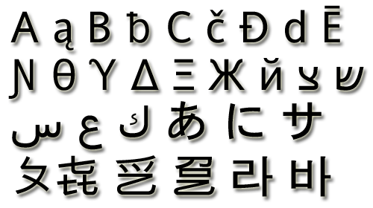
The Character Data Type
The character data type in C#
Represents symbolic information
Is declared by the char keyword
Gives each symbol a corresponding integer code
Has a '\0' default value
Takes 16 bits of memory (from U+0000 to U+FFFF)
Holds a single Unicode character (or part of character)

Slide 36
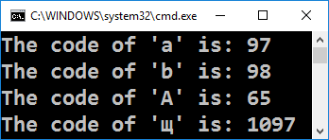
Characters and Codes
Each character has an unique Unicode value (int):
char ch = 'a';
Console.WriteLine("The code of '{0}' is: {1}", ch, (int) ch);
ch = 'b';
Console.WriteLine("The code of '{0}' is: {1}", ch, (int) ch);
ch = 'A';
Console.WriteLine("The code of '{0}' is: {1}", ch, (int) ch);
ch = 'щ'; // Cyrillic letter 'sht'
Console.WriteLine("The code of '{0}' is: {1}", ch, (int) ch);

Slide 37
Problem: Triples of Latin Letters
Write a program to read an integer n and print all triples of the first n small Latin letters, ordered alphabetically:
aaa
aab
aac
aba
abb
abc
aca
acb
acc
baa
bab
bac
bba
bbb
bbc
bca
bcb
bcc
caa
cab
cac
cba
cbb
cbc
cca
ccb
ccc
3
Check your solution here: https://judge.softuni.bg/Contests/Practice/Index/171#5
Notes:
Goes to exercise

Slide 38
Solution: Triples of Latin Letters
int n = int.Parse(Console.ReadLine());
for (int i1 = 0; i1 < n; i1++)
for (int i2 = 0; i2 < n; i2++)
for (int i3 = 0; i3 < n; i3++)
{
char letter1 = (char)('a' + i1);
char letter2 = // TODO: finish this
char letter3 = // TODO: finish this
Console.WriteLine("{0}{1}{2}",
letter1, letter2, letter3);
}
Check your solution here: https://judge.softuni.bg/Contests/Practice/Index/171#5

Slide 39
Escaping Characters
Escaping sequences are:
Represent a special character like ', " or \n (new line)
Represent system characters (like the [TAB] character \t)
Commonly used escaping sequences are:
\' → for single quote \" → for double quote
\\ → for backslash \n → for new line
\uXXXX → for denoting any other Unicode symbol

Slide 40
Character Literals – Example
char symbol = 'a'; // An ordinary character
symbol = '\u006F'; // Unicode character code in a
// hexadecimal format (letter 'o')
symbol = '\u8449'; // 葉 (Leaf in Traditional Chinese)
symbol = '\''; // Assigning the single quote character
symbol = '\\'; // Assigning the backslash character
symbol = '\n'; // Assigning new line character
symbol = '\t'; // Assigning TAB character
symbol = "a"; // Incorrect: use single quotes!

Slide 41

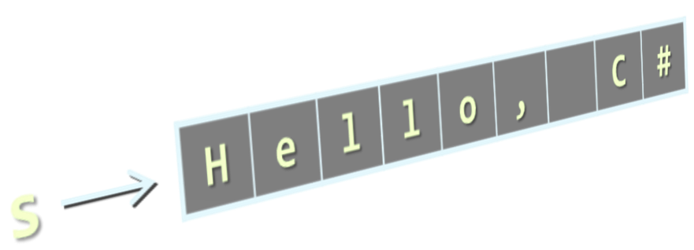
The String Data Type
The string data type in C#
Represents a sequence of characters
Is declared by the string keyword
Has a default value null (no value)
Strings are enclosed in quotes:
Strings can be concatenated
Using the + operator
string
string s = "Hello, C#";

Slide 42
Verbatim and Interpolated Strings
The backslash \ is escaped by \\
Strings are enclosed in quotes "":
Strings can be verbatim (no escaping):
Interpolated strings insert variable values by pattern:
string file = "C:\\Windows\\win.ini";
The backslash \ is not escaped
string file = @"C:\Windows\win.ini";
string firstName = "Svetlin";
string lastName = "Nakov";
string fullName = $"{firstName} {lastName}";

Slide 43
Saying Hello – Examples
Combining the names of a person to obtain the full name:
We can concatenate strings and numbers by the + operator:
string firstName = "Ivan";
string lastName = "Ivanov";
Console.WriteLine(@"Hello, ""{0}""!", firstName);
string fullName = $"{firstName} {lastName}";
Console.WriteLine("Your full name is {0}.", fullName);
int age = 21;
Console.WriteLine("Hello, I am " + age + " years old");

Slide 44
Problem: Greeting by Name and Age
Write a program that enters first name, last name and age and prints "Hello, <first name> <last name>. You are <age> years old."
string firstName = Console.ReadLine();
string lastName = Console.ReadLine();
string ageStr = Console.ReadLine();
int age = int.Parse(ageStr); // Parse string → int
Console.WriteLine($"Hello, {firstName} {lastName}.\r\nYou are {age} years old.");
Check your solution here: https://judge.softuni.bg/Contests/Practice/Index/171#6

Slide 45
Data Types
string
(int) value
bool
switch
case
char
Live Exercises in Class (Lab)

Slide 46
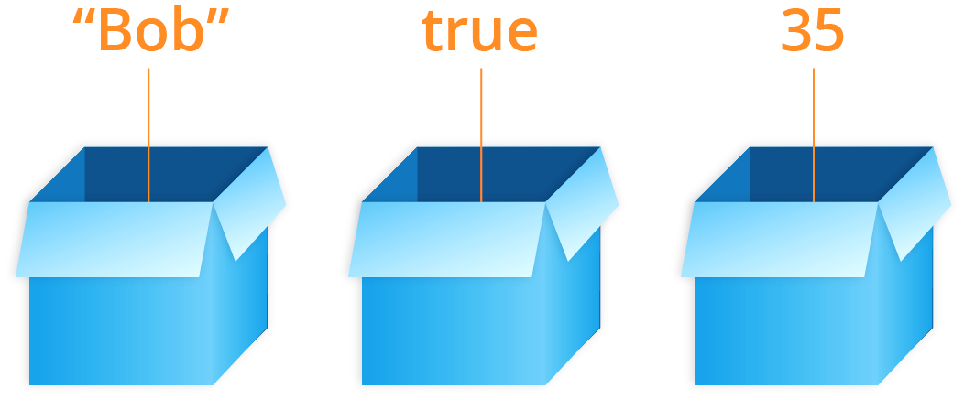
Variables

Slide 47
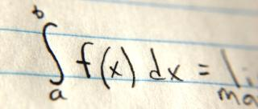


Naming Variables
Variable names
Always refer to the naming conventions of a programming language – for C# use camelCase
Preferred form: [Noun] or [Adjective] + [Noun]
Should explain the purpose of the variable (Always ask yourself "What this variable contains?")
firstName, report, config, usersList, fontSize, maxSpeed
foo, bar, p, p1, p2, populate, LastName, last_name, LAST_NAME

Slide 48
Variable Scope and Lifetime
Scope == where you can access a variable (global, local)
Lifetime == how long a variable stays in memory
static void Main()
{
string outer = "I'm inside the Main()";
for (int i = 0; i < 10; i++)
{
string inner = "I'm inside the loop";
}
Console.WriteLine(outer);
// Console.WriteLine(inner); // Error
}
Accessible in the Main()
Accessible only in the loop

Slide 49
Variable Span
Variable span is how long before a variable is called
Always declare a variable as late as possible (e.g. shorter span)
static void Main()
{
string outer = "I'm inside the Main()";
for (int i = 0; i < 10; i++)
{
string inner = "I'm inside the loop";
}
Console.WriteLine(outer);
// Console.WriteLine(inner); // Error
}
"outer" variable span

Slide 50
Keep Variable Span Short
Shorter span simplifies the code
Improves its readability and maintainability
static void Main()
{
for (int i = 0; i < 10; i++)
{
string inner = "I'm inside the loop";
}
string outer = "I'm inside the Main()";
Console.WriteLine(outer);
// Console.WriteLine(inner); // Error
}
"outer" variable span – reduced

Slide 51
Problem: Refactor Volume of Pyramid
You are given a working code finding the volume of a pyramid:
Fix the naming, variable span and multi-purpose variables
double dul, sh, V = 0;
Console.Write("Length: ");
dul = double.Parse(Console.ReadLine());
Console.Write("Width: ");
sh = double.Parse(Console.ReadLine());
Console.Write("Height: ");
V = double.Parse(Console.ReadLine());
V = (dul * sh * V) / 3;
Console.WriteLine("Pyramid Volume: {0:F2}", V);
Check your solution here: https://judge.softuni.bg/Contests/Practice/Index/171#7

Slide 52
Problem: Refactor Special Numbers
int kolkko = int.Parse(Console.ReadLine());
int obshto = 0; int takova = 0; bool toe = false;
for (int ch = 1; ch <= kolkko; ch++)
{
takova = ch;
while (ch > 0)
{
obshto += ch % 10;
ch = ch / 10;
}
toe = (obshto == 5) || (obshto == 7) || (obshto == 11);
Console.WriteLine($"{takova} -> {toe}");
obshto = 0; ch = takova;
}
Check your solution here: https://judge.softuni.bg/Contests/Practice/Index/171#8

Slide 53
Variables
Live Exercises in Class (Lab)

Slide 54

Summary
Classical data types:
Numeral types: represent numbers
Have specific ranges for every type
String and text types: represent text
Sequences of Unicode characters
Type conversion: implicit and explicit
Variables – store data
Name wisely, reduce their scope, span and lifetime

Slide 55










Programming Fundamentals – Data Types
https://softuni.bg/courses/programming-fundamentals

Slide 56
License
This course (slides, examples, demos, videos, homework, etc.) is licensed under the "Creative Commons Attribution-NonCommercial-ShareAlike 4.0 International" license

Slide 57





Trainings @ Software University (SoftUni)
Software University – High-Quality Education, Profession and Job for Software Developers
softuni.bg
Software University Foundation
http://softuni.foundation/
Software University @ Facebook
facebook.com/SoftwareUniversity
Software University Forums
forum.softuni.bg

